Slide 1

NHANES Data Explorer Web Application
Office on Smoking and Health
Aaron Adams, Research Team
Kevin Caron, Evaluation Team
Wednesday, June 12, 2024 Branch Epidemiology All-Hands Meeting

Slide 2
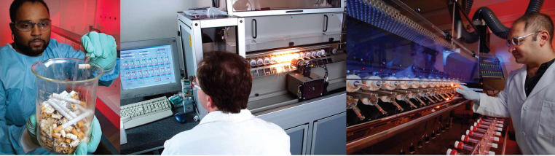
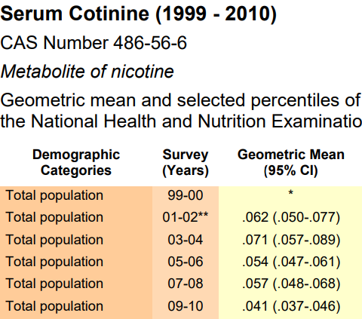
Introductions
Scientists in CDC’s Tobacco Products Laboratory info
Tobacco and Volatiles Branch, Division of Laboratory Sciences, National Center for Environmental Health
Measures:
Chemicals in Tobacco Products
Chemicals in Human Biological Fluids (Biomarkers)
Volatile Organic Compounds
National Health and Nutrition Examination Survey
Provides samples for analysis
Results displayed in the National Exposure Report biomonitoring tables.

Slide 3

NHANES
NHANES Mobile Examination Clinic
About NHANES
A program of studies dedicated to assessing the health and nutritional status of adults and children in the U.S. (2-year periods)
Protocol:
Home interview
Physical examination/Interview in a mobile examination center
Biomarker Data
Blood and Urine are collected and sent to CDC or partner laboratories for analysis.

Slide 4
Biomarker
NHANES Mobile Examination Clinic
About NHANES
A program of studies dedicated to assessing the health and nutritional status of adults and children in the U.S.
Protocol:
Home interview
Physical examination/Interview in a mobile examination center
Biomarker Data
Blood and Urine are collected and sent to CDC or partner laboratories for analysis.

Slide 5
Application Demonstrations
#1 Unweighted Exploration of NHANES Data
#2 Weighted Analysis of NHANES Data (password protected)

Slide 6
Section Divider
Subtitle

Slide 7
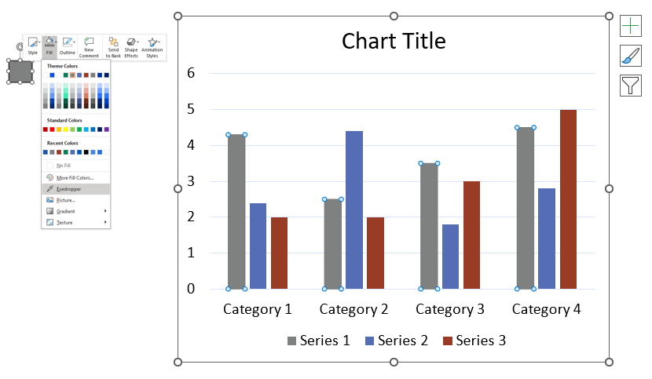
Colors
Customize chart colors to match your presentation
HINT: Use the eyedropper tool in the FILL menu to sample colors

Slide 8
Side-By-Side Display
Bullet
Sub bullet

Slide 9
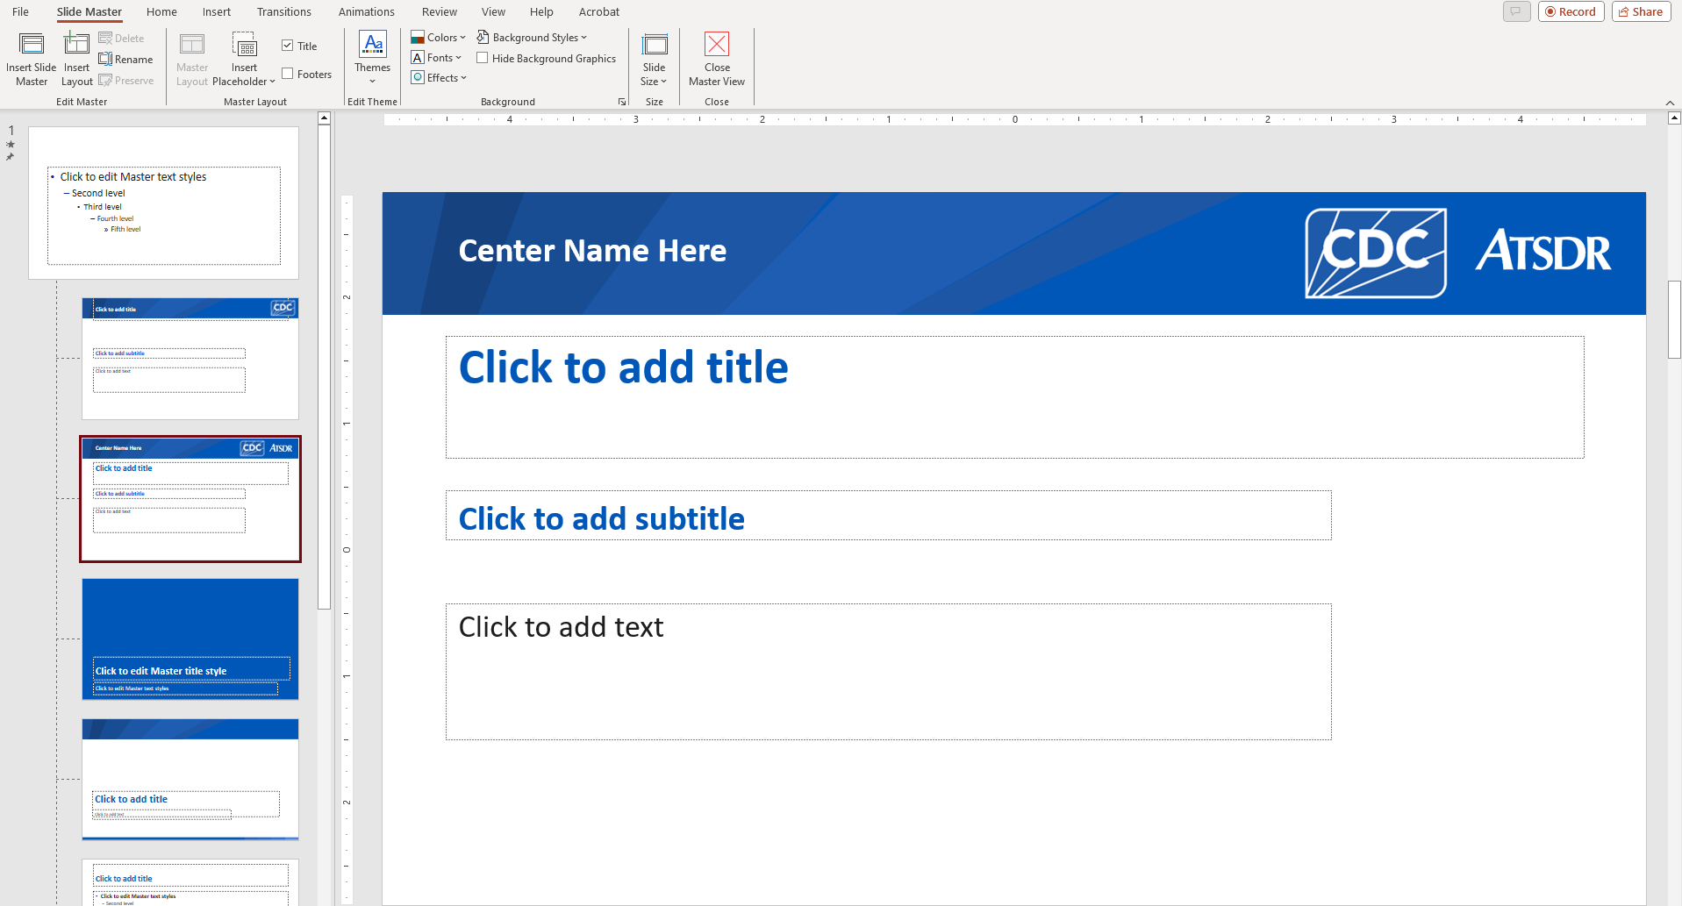
Use Slide Master Pages
Critical to the functionality of your slide deck
Necessary for 508 remediation

Slide 10
Closing Slide / Disclaimer

